Slide 1
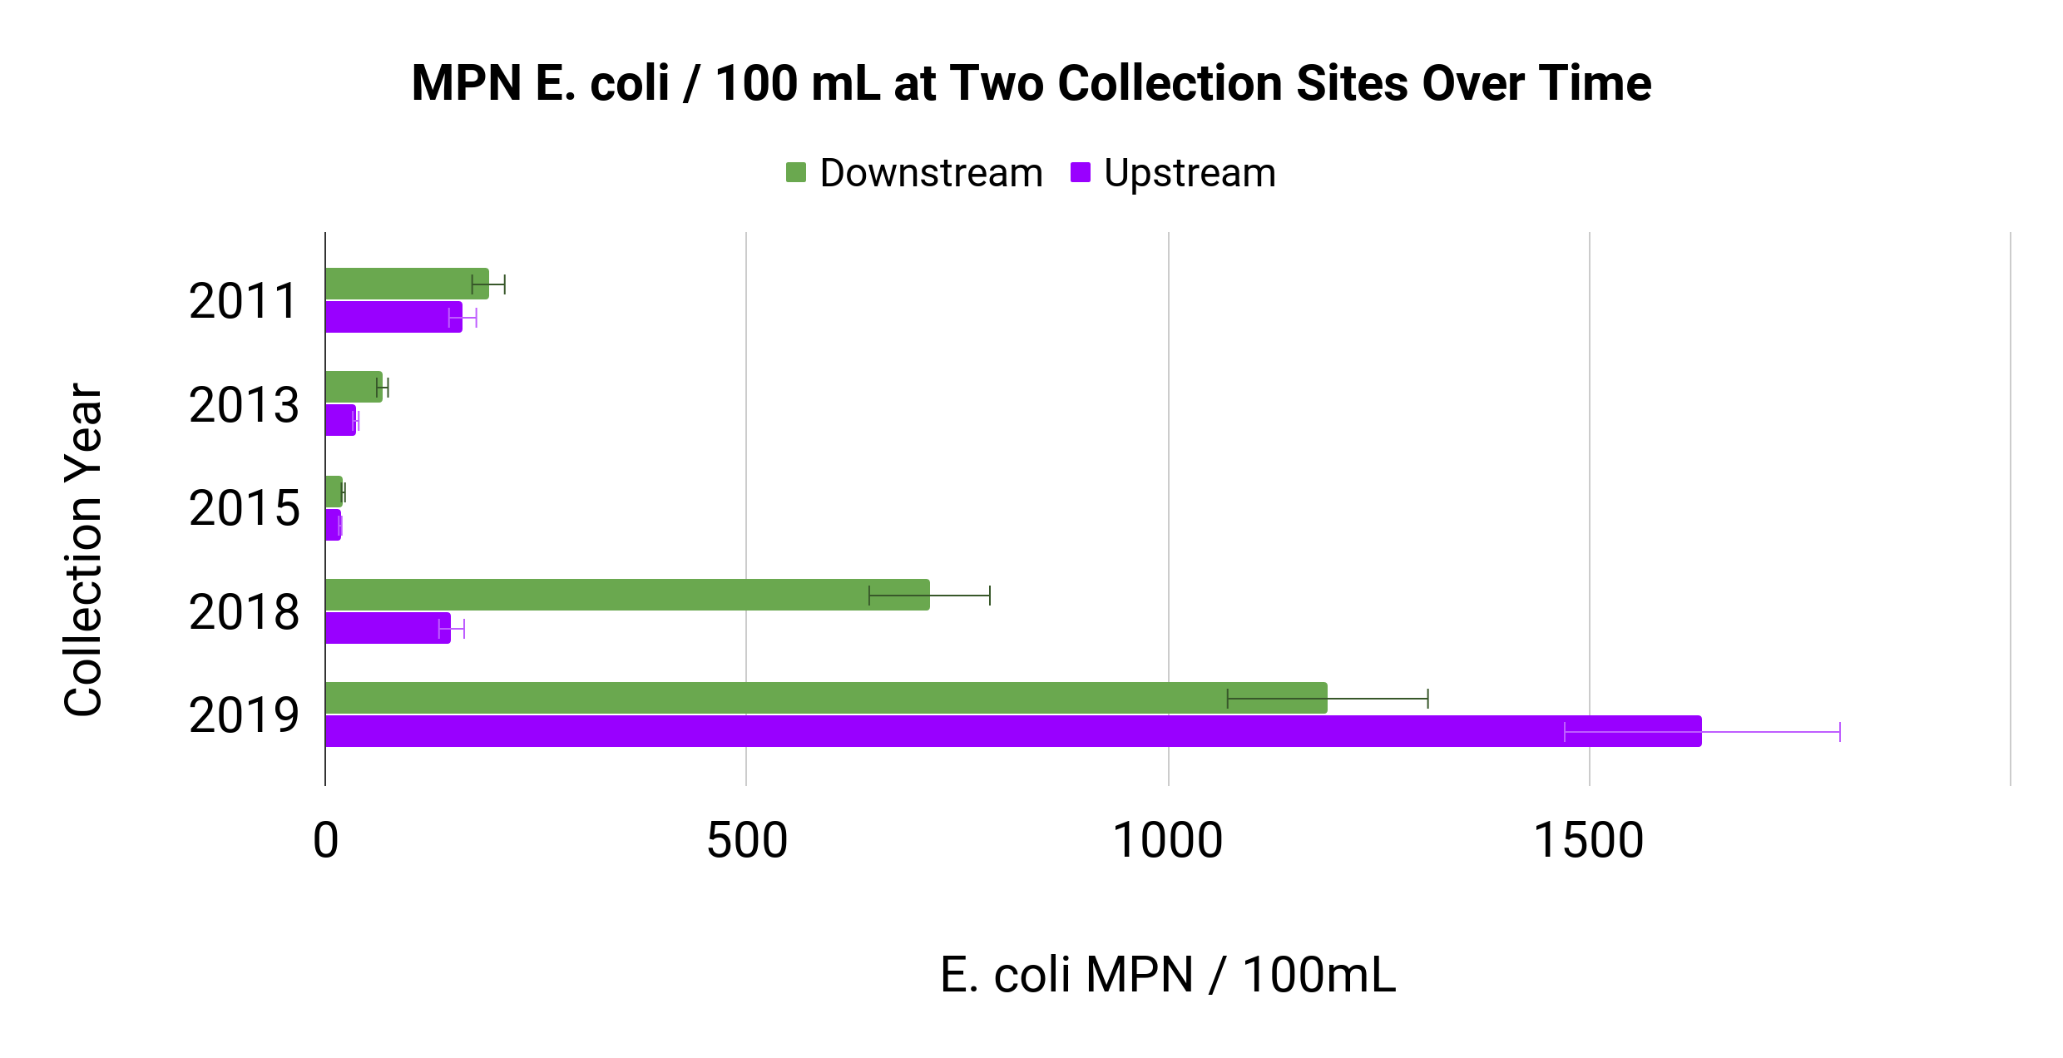
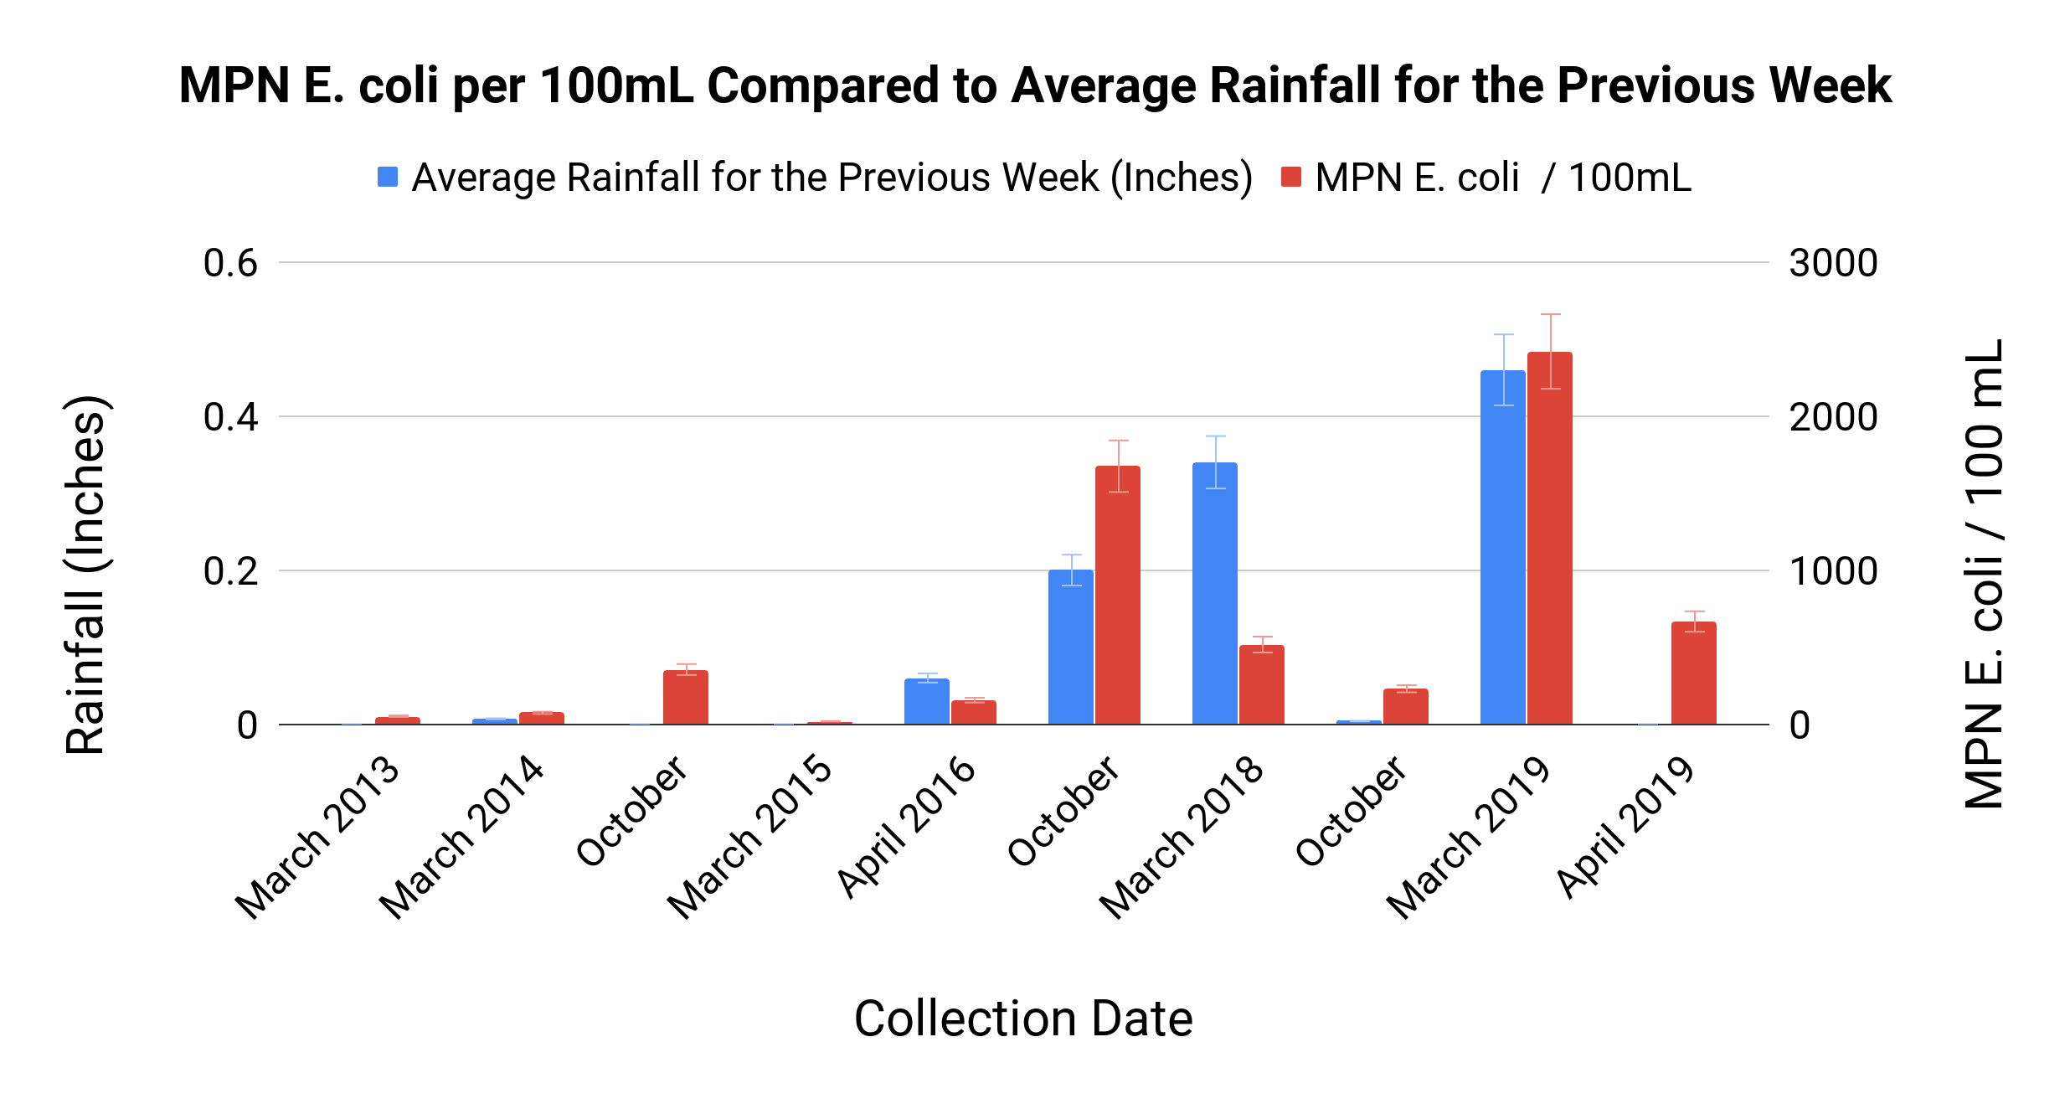
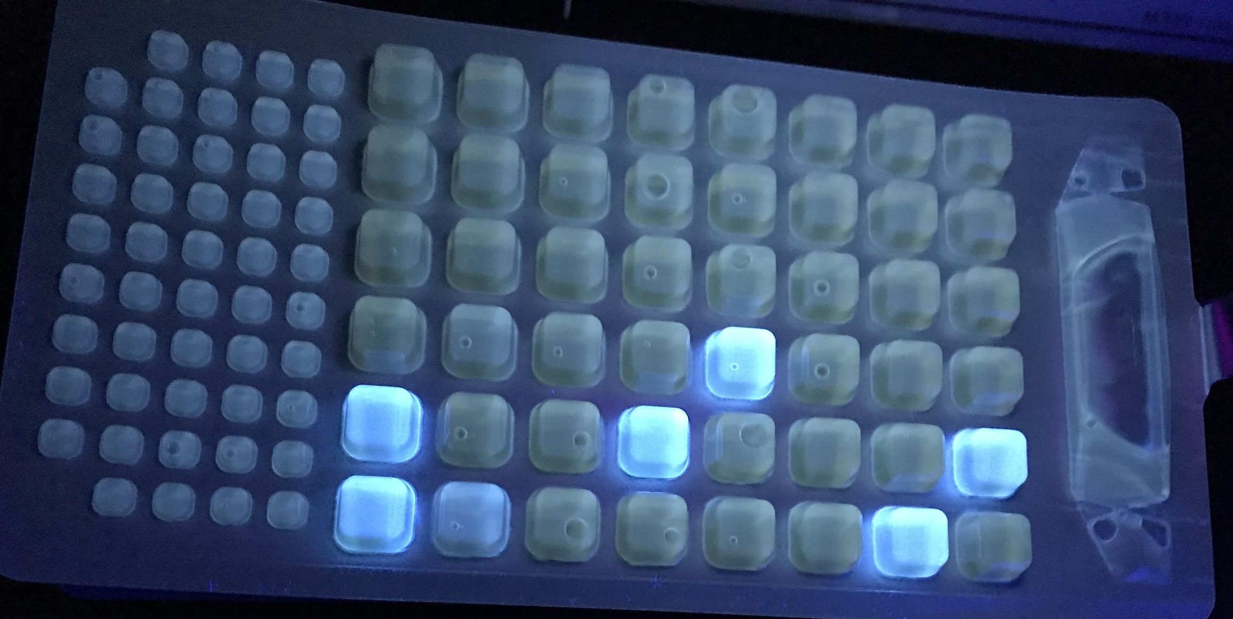
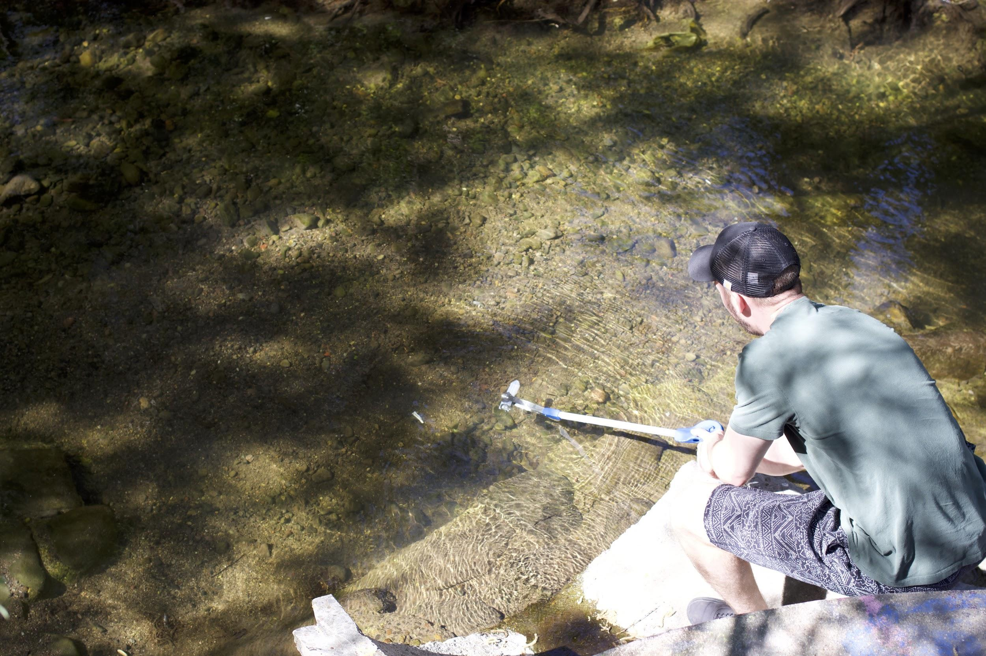
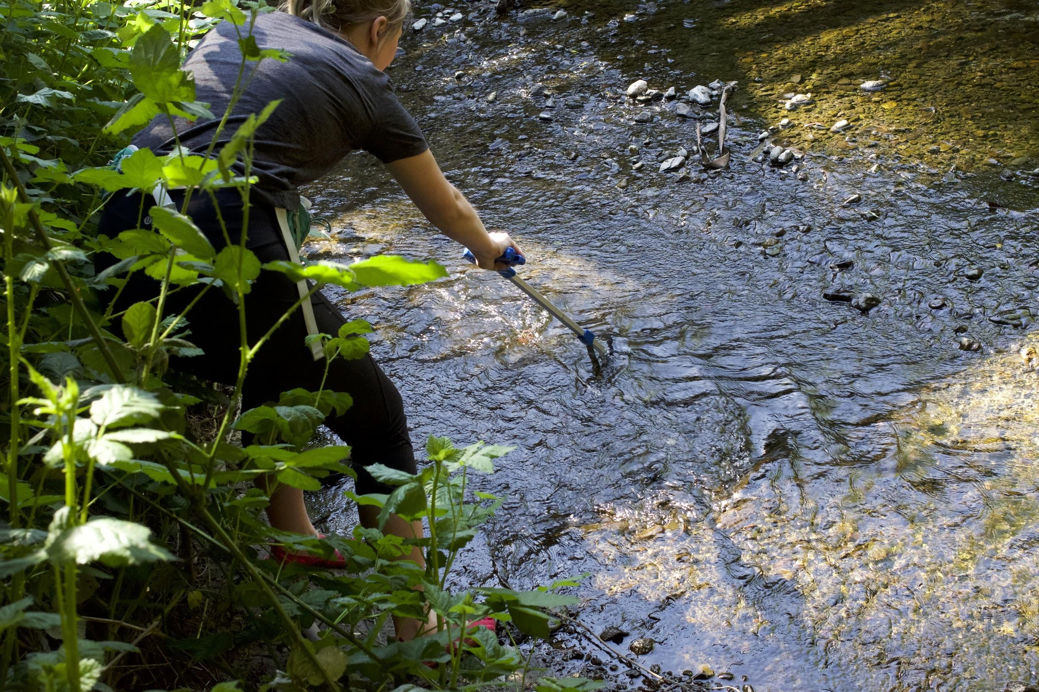
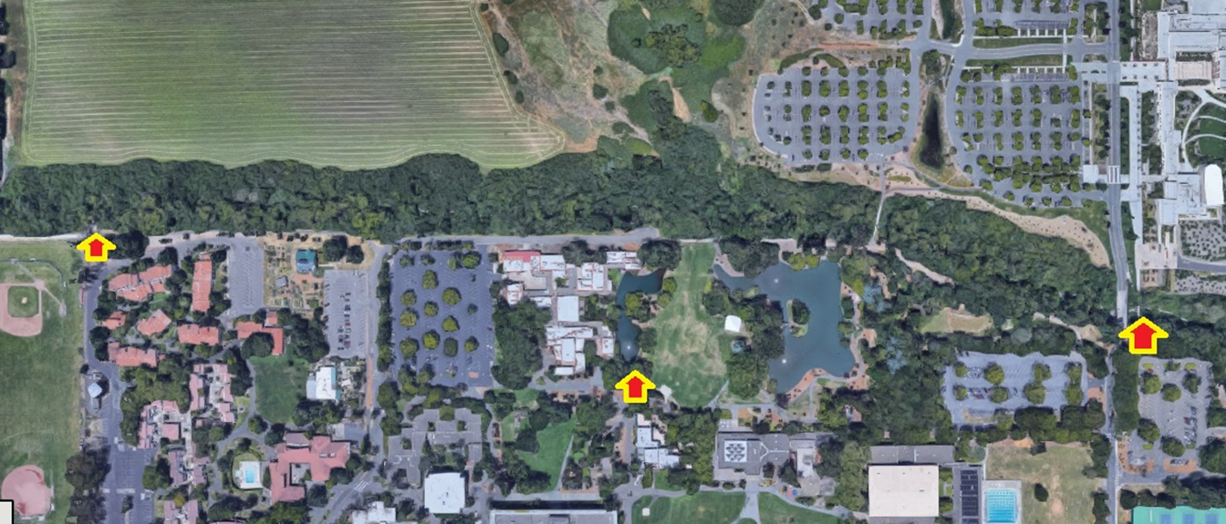
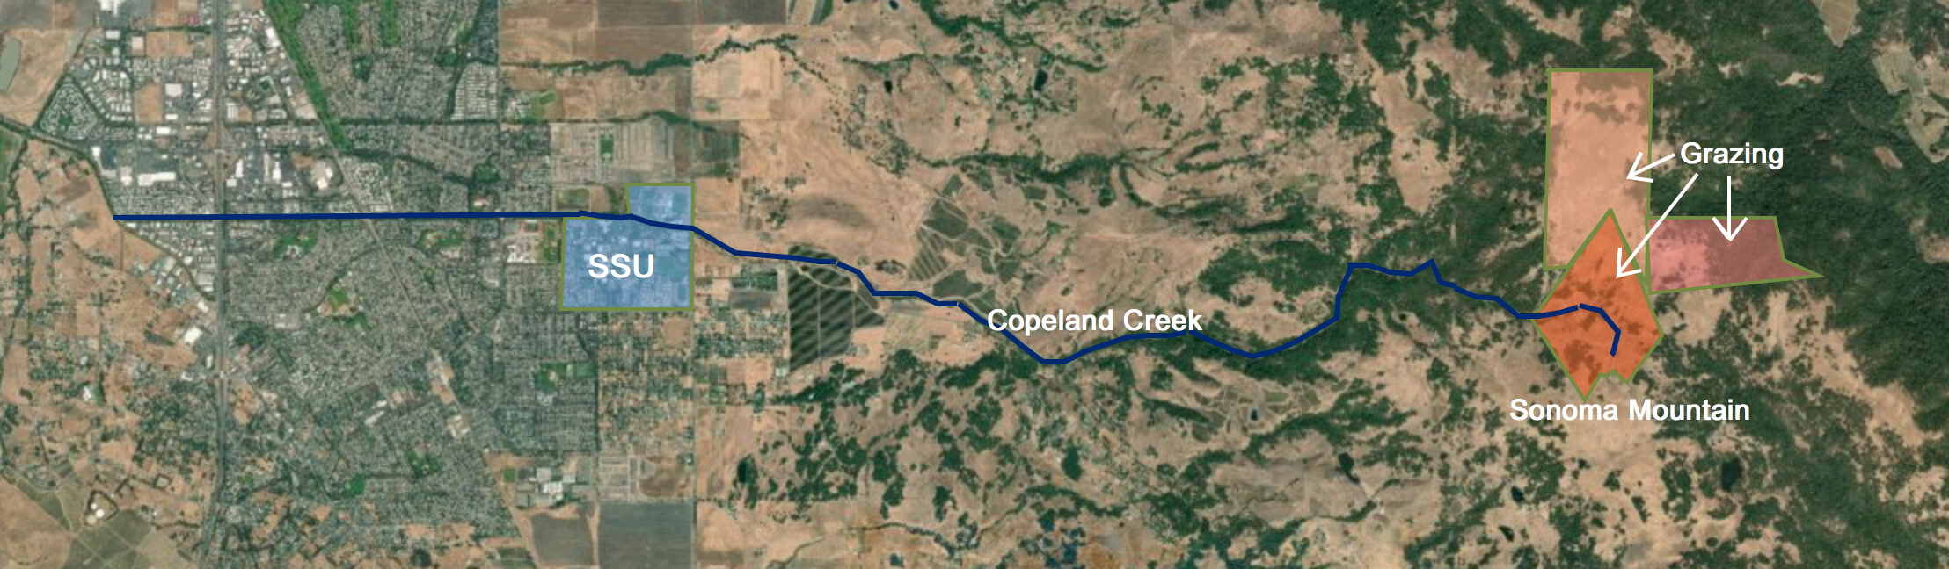
Elevated E. coli Levels in Copeland Creek Following Heavy Rainfall
Melissa Criddle & Michael Wickenden
Dr. Michael Cohen - Biology 338
Sonoma State University, Department of Biology and WATERS Collaborative
Introduction
Results
Conclusions and Further Research
US EPA guidelines prescribe a 126 MPN / 100mL limit for E. coli in recreational waterways.
Sonoma Mountain Institute began a 1,037 acre restorative grazing project on the top of Sonoma Mountain in 2015.
Eliminating the E. coli from waterways must be undertaken to ensure protection of the local population.
Increasing E. coli numbers may not be from an increase in rainfall alone.
Fecal matter arising from restorative grazing on Sonoma Mountain may travel into Copeland Creek during periods of heavy rain.
Water samples should be taken more often and from sites near the restoration grazing projects.
Beginning of Restorative Grazing
Acknowledgements
Data from BIOL 338 and BIOL 340 students
Thanks to continued funding from WATERS
Materials and Methods
Samples were obtained from three sites along Copeland Creek on the Sonoma State campus.
Samples were collected in March, 2019 following heavy rain and April 2019 in dry weather.
Samples were analyzed using IDEXX-2000.
The trays were then sealed and incubated at 37ºC for 24 hours.
The trays were exposed to UV light; fluorescent wells indicated positive E. coli contamination.
References
Sonoma Mountain Institute:
http://sonomamountaininstitute.org/management-location/
California Irrigation Management Information System: https://cimis.water.ca.gov
USEPA. 1986. Bacteriological ambient water quality criteria for marine and fresh recreational waters. EPA 440/5-84-002. U.S. Environmental Protection Agency.
Beginning of Restorative Grazing
Increase in suspended sediment
E. coli levels positively correlate with rainfall.
Suspended sediment in the water was noted during the March, 2019 collection.
Three sites of restorative grazing intersect with the origin of Copeland Creek.
Water samples collected along the creek.
IDEXX- 2000 tray exposed to UV light showing positive results for E. coli.
Sampling locations at Sonoma State University.
Sonoma Mountain Institute restorative grazing sites along Copeland Creek.

